Slide 1
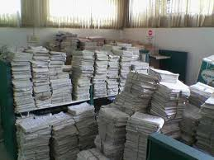

The solicitor's role
Gathering the evidence
  Disclosure in most cases:
  Disclosure in most fraud cases:

Slide 2
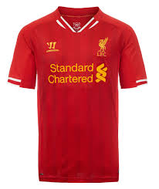
Cypriot search order
Jason Hercules
Use of backdated trust documents
"the date we have in the trust deed.... the date we need...."

Slide 3

Yahoo!
Disclosure order made against the address "Ys_myr@yahoo.co.uk" (Syrym)
c.30 files of emails and attachments disclosed

Slide 4

Yahoo!
Repeated orders against numerous accounts – all then believed to be run by Shalabayev – c.70 files of emails and attachments disclosed
Effectively permitted real-time monitoring of the accounts without the account-holder's knowledge

Slide 5
Yahoo!
Demonstrated non-disclosure of assets on a massive scale
Also demonstrated ongoing dealings in frozen assets
→ Allowed a committal application to be brought in relation to 19 allegations of non-disclosure and 13 allegations of dealings with frozen assets

Slide 6
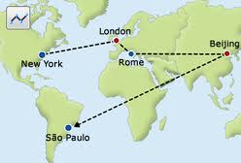
IP addresses
Yahoo! also required to provide the IP addresses from which the accounts were accessed:
  provides information which can be used to track a fugitive
  used to prove that all the accounts were in fact being administered by Shalabayev

Slide 7
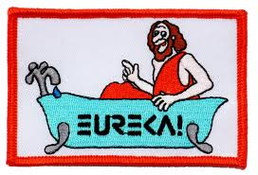
The upshot
"The stuff that litigators' dreams are made of"
Eureka!

Slide 8
www.hoganlovells.com
Hogan Lovells has offices in:
Alicante
Amsterdam
Baltimore
Beijing
Berlin
Brussels
Budapest*
Caracas
Colorado Springs
Denver
Dubai
Dusseldorf
Frankfurt
Hamburg
Hanoi
Ho Chi Minh City
Hong Kong
Houston
Jakarta*
Jeddah*
London
Los Angeles
Madrid
Miami
Milan
Moscow
Munich
New York
Northern Virginia
Paris
Philadelphia
Prague
Riyadh*
Rome
San Francisco
Shanghai
Silicon Valley
Singapore
Tokyo
Ulaanbaatar
Warsaw
Washington DC
Zagreb*
"Hogan Lovells" or the "firm" is an international legal practice that includes Hogan Lovells International LLP, Hogan Lovells US LLP and their affiliated businesses.
The word "partner" is used to describe a partner or member of Hogan Lovells International LLP, Hogan Lovells US LLP or any of their affiliated entities or any employee or consultant with equivalent standing. Certain individuals, who are designated as partners, but who are not members of Hogan Lovells International LLP, do not hold qualifications equivalent to members.
For more information about Hogan Lovells, the partners and their qualifications, see www.hoganlovells.com.
Where case studies are included, results achieved do not guarantee similar outcomes for other clients. Attorney Advertising.
© Hogan Lovells 2013. All rights reserved.
*Associated offices
Notes:
8

