Slide 1


CONFLICT AND CONFIDENTIALITY: DISCLOSURE FOLLOWING BANK MELLAT
Philippa Hopkins q.c. AND HELEN MORTON

Slide 2
BANK MELLAT: the dispute and the history
Financial Restrictions Order (Iran) 2009 made by HMT under Schedule 7 to Counter-Terrorism Act 2008
Precluded any credit or financial institution from entering into or continuing to participate in any transaction or business relationship with “designated persons”
Bank Mellat a “designated person”

Slide 3
BANK MELLAT: the dispute and the history
November 2009: action by Bank under section 63 of the CTA and CPR Part 79 to have the direction contained in the 2009 Order set aside and to recover damages under the Human Rights Act 1998
Bank lost before Mitting J [2010] Lloyd’s Rep FC 504 and CA [2012] QB 101
But majority of UKSC allowed the Bank’s claim [2014] AC 700

Slide 4
BANK MELLAT: THE DISPUTE AND THE HISTORY
UKSC remitted the Bank’s HRA 1998 claim to the Administrative Court
Then transferred to the Commercial Court
Preliminary issues determined by Flaux J in May 2015 (appeal to the CA – judgment in 2016 [2016] EWCA Civ 452
In October 2018, proceedings were consolidated with Bank’s challenge to two subsequent (2011 and 2012) financial restrictions orders
Trial was fixed to be heard by Popplewell J over 5 weeks from 17 June 2019

Slide 5
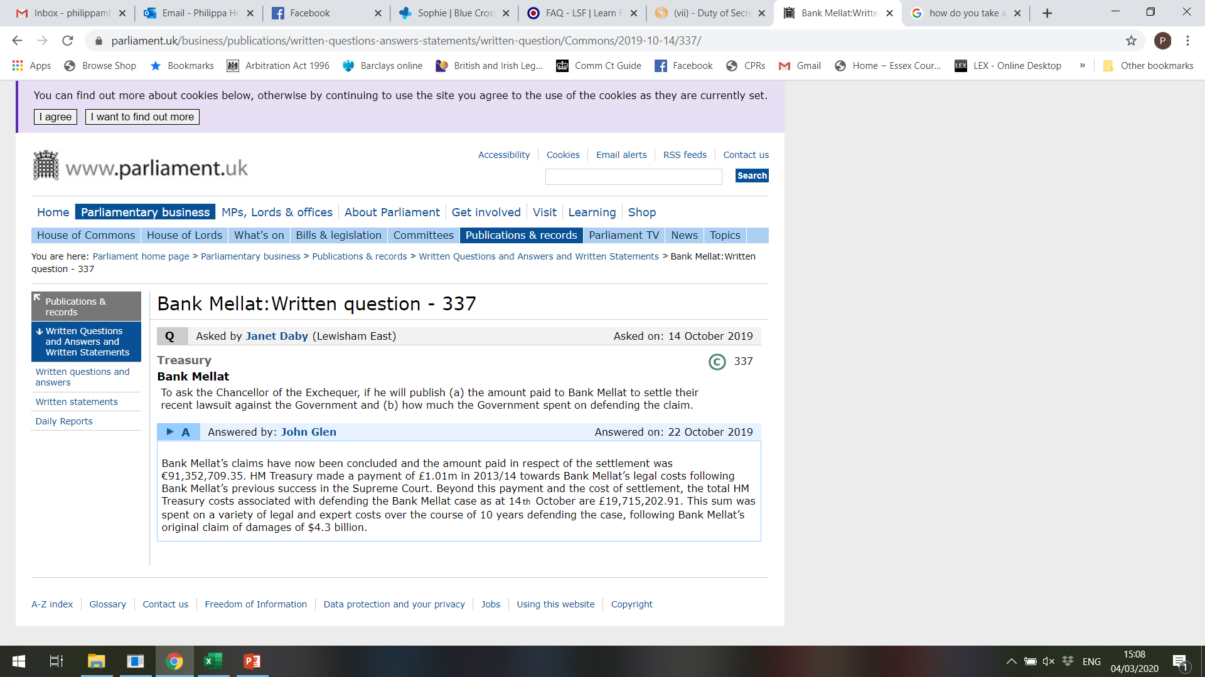
BANK MELLAT: the dispute and the history

Slide 6
BANK MELLAT: THE CLAIMS
Bank’s original damages claim was for $4.3 billion (later reduced to $1.7 billion) for interference with enjoyment of its possessions (HRA A1P1) caused by:
The original 2009 Order;
Other measures implemented by the EU and the UN against the Bank, which the Bank claimed were the result of the 2009 Order;
Other measures in other jurisdictions, notably Dubai and South Korea;
The 2011 and 2012 HMT Orders.

Slide 7
BANK MELLAT: THE CLAIMS
The Bank claimed that it had suffered loss as follows (after amendments to its SOC):
FX letters of credit: loss of commission, loss of return on collateral, loss on associated FX transactions
FX bank guarantees: loss of commission, loss of return on collateral
Loss on putative discounted export LC business
Seoul branch losses (mostly FX LCs)
Loss on “affected transactions” – LCs, BGs, penalty payments

Slide 8
BANK MELLAT: THE CLAIMS
Majority of claims: Bank asked Court to assess loss on a “before and after” or loss of market approach
2500 specific transactions said to have been directly affected by the 2009 Order and identified in an XL “Schedule of Affected Transactions”

Slide 9
BANK MELLAT: the issues
The issues which the Court would have had to decide included:
What “possessions” of the Bank had been interfered with?
Were they interfered with by the 2009 Order?
What responsibility, if any, did HMT have for interference resulting from other measures, whether national or transnational?
What was the quantum of loss?
Was an award of damages necessary to give “just satisfaction” to the Bank?

Slide 10
BANK MELLAT: DISCLOSURE GENERALLY
Difficult case for disclosure generally:
HMT’s pleadings and disclosure were the subject of a Closed Material Procedure under CPR Part 79.25
Bank’s disclosure spread across many sites in Iran; mainly hard copy
10% “sample” disclosure given on “affected transactions”
Farsi translation difficulties
Resourcing issues on both sides
Trial was adjourned three times

Slide 11
BANK MELLAT: THE REDACTIONS ISSUE
Bank had indicated before disclosure that might be redactions
Flaux J order, July 2016:
“In so far as the Claimant contends that it has a right or a duty to withhold inspection of any document, or any part of any document, it shall state that it has such right or duty in its supplemental disclosure statement and list and specify the grounds upon which it claims that right or duty. The Defendant has liberty to apply in the event that there is any dispute as to the Claimant’s entitlement to withhold inspection.”

Slide 12
BANK MELLAT: THE REDACTIONS ISSUE
Bank’s disclosure, both transaction-specific documents and general documents (memoranda and similar) redacted customer names.
Disclosure statement: “The Bank asserts that it has a right or duty under Iranian Law and/or Korean Law and/or Turkish Law to redact information relating to their customers when giving inspection to HM Treasury. Such right or duty is being asserted based on the expert reports on Iranian, Korean and Turkish Law served with this disclosure statement.”
Basis of objection: customer names were confidential, and the production of unredacted documents, even in response to an order, would expose the Bank and its officials to the risk of prosecution in the countries concerned.

Slide 13
BANK MELLAT: THE REDACTIONS ISSUE
Hearing before Cockerill J in September 2018
Expert reports on Turkish and Korean law from both parties but only from Bank on Iranian law
Cockerill J ordered that production of unredacted Iranian and Korean documents should be given
Protection for the Bank: documents were to be ciphered, with a master list given only to a confidentiality club of named individuals
The Bank appealed (in relation to Iran only)

Slide 14
BANK MELLAT: The redactions issue
The law before Bank Mellat:
“… confidentiality (where it is asserted) is a relevant factor to be taken into account by the court in determining whether or not to order inspection. The court's task is to strike a just balance between the competing interests involved—those of the party asserting an entitlement to inspect the documents and those of the party claiming confidentiality in the documents. In striking that balance in the exercise of its discretion, the court may properly have regard to the question of whether inspection of the documents is necessary for disposing fairly of the proceedings in question: see Science Research Council v Nassé [1980] AC 1028 , especially pp 1065–1066 (Lord Wilberforce), p 1074 (Lord Edmund-Davies) and pp 1087–1088 (Lord Scarman)”
(National Crime Agency v. Abacha [2016] 1 W.L.R. 4375, per Gross LJ at § 31).

Slide 15
BANK MELLAT: The redactions issue
Handful of cases dealing with the balance to be struck when production would be criminal under the relevant foreign law, but in very different circumstances:
Morris v. Banque Arab et Internationale d’Investissement SA [2000] CP Rep 65
Cadogan Petroleum plc v. Tolley [2009] EWHC 3291 (Ch)
Secretary of State for Health v. Servier Laboratories Ltd [2014] 1 W.L.R. 4383
(on privilege against self-incrimination) Brannigan v Davison [1997] A.C. 238

Slide 16
Bank mellat: THE APPEAL
The issues as the CA saw them were:
The extent of the risk of prosecution if the Bank complied with the Judge’s order;
The importance of the unredacted documents to the fair disposal of the trial; and
How to strike the right balance between those factors as a matter of discretion.

Slide 17
Bank mellat: THE APPEAL
The Bank agreed to provide ciphered documents but with no master list. It argued that:
the Judge had misread the uncontradicted expert evidence, which demonstrated that there was a real risk of prosecution;
unredacted documents were not critical to the resolution of the dispute;
HMT’s interests were sufficiently protected by receiving ciphered documents;
the Bank should not be put in a position where it could only have its rights fairly determined by committing a crime in Iran;
if the order was upheld, it would not comply with it.

Slide 18
BANK MELLAT: the appeal
HMT argued:
The Judge’s decision was a case management decision with which the CA should not interfere;
The expert evidence did not demonstrate a real risk of prosecution;
The case could not be fairly decided without HMT knowing customer identities.

Slide 19
BANK MELLAT: THE APPEAL
The CA upheld the Judge’s order [2019] EWCA Civ 449:
It was found that the Judge had exercised her discretion correctly:
She was entitled to conclude that their was insufficient evidence of a serious risk of prosecution under Iranian law;
She was not bound by the expert evidence (the issue not being one of foreign law);
She was entitled to conclude that the need for unredacted documents outweighed the risks of prosecution.

Slide 20
BANK MELLAT: the appeal
At [63] (emphasis added):
  “i) In respect of litigation in this jurisdiction, this Court (i.e., the English Court) has jurisdiction to order production and inspection of documents, regardless of the fact that compliance with the order would or might entail a breach of foreign criminal law in the "home" country of the party the subject of the order.
  ii) Orders for production and inspection are matters of procedural law, governed by the lex fori , here English law. Local rules apply; foreign law cannot be permitted to override this Court's ability to conduct proceedings here in accordance with English procedures and law.
  iii) Whether or not to make such an order is a matter for the discretion of this Court. An order will not lightly be made where compliance would entail a party to English litigation breaching its own (i.e., foreign) criminal law, not least with considerations of comity in mind (discussed in Dicey, Morris and Collins, op cit, at paras. 1-008 and following). This Court is not, however, in any sense precluded from doing so.

Slide 21
BANK MELLAT: the appeal
  iv) When exercising its discretion, this Court will take account of the real – in the sense of the actual – risk of prosecution in the foreign state. A balancing exercise must be conducted, on the one hand weighing the actual risk of prosecution in the foreign state and, on the other hand, the importance of the documents of which inspection is ordered to the fair disposal of the English proceedings. The existence of an actual risk of prosecution in the foreign state is not determinative of the balancing exercise but is a factor of which this Court would be very mindful.
  v) Should inspection be ordered, this Court can fashion the order to reduce or minimise the concerns under the foreign law, for example, by imposing confidentiality restrictions in respect of the documents inspected.
  vi) Where an order for inspection is made by this Court in such circumstances, considerations of comity may not unreasonably be expected to influence the foreign state in deciding whether or not to prosecute the foreign national for compliance with the order of this Court. Comity cuts both ways.”

Slide 22
BANK MELLAT: immediate impacts
How does the decision affect a party seeking to withhold production of documents because of a risk of prosecution?
“Hardline” decision
Choose your expert carefully – do you need more than one to cover (a) the law and (b) the actual risk of prosecution?
“Middle ways” – confidentiality clubs, ciphering
Consider time and costs of protective measures
Advise clients of consequence of non-compliance

Slide 23
BANK MELLAT: IMMEDIATE IMPACTS
How does the decision affect a party seeking to obtain inspection of documents?
Don’t be over-optimistic – if the evidence had been different in Mellat, the result might have been too
Consider carefully the reasons why production is really necessary
Consider and engage with “middle ways”, taking on board time and cost considerations

Slide 24
Bank mellat: wider impacts
Subsequent cases and comment:
Thum v. Thum [2019] EWFC 25
Akhmedova v. Akhmedov [2019] EWHC 2561 (Fam)
Rogerson: The place of comity in the disclosure of documents (C.L.J. 2019, 78(3), 483-486)

Slide 25
BANK MELLAT: WIDER IMPACTS
Confidentiality more generally:
Is the wider position affected?
General trends – National Crime Agency v. Abacha [2016] 1 W.L.R. 4375, Dechert LLP v. Eurasian Natural Resources Corporation Ltd. [2016] EWCA Civ 375
Minera Las Bambas SA v. Glencore Queensland Ltd. [2018] EWHC 286 (Comm.) at [37] (Moulder J.): “Confidentiality is a relevant factor, but it does not (on its own) justify a refusal to inspect... The question of whether inspection is necessary to dispose fairly of the proceedings is a relevant factor, but it is not “a free-standing hurdle to be considered and surmounted in isolation before inspection may be permitted””.

Slide 26
BANK MELLAT: WIDER IMPACTS
Banker/customer relationship issues:
Duty of secrecy/confidentiality under English law
Exceptions include legal compulsion (but court will need, again, to balance the competing considerations), public interest, protection by bank of its own interests, express or implied customer consent
Is there an inconsistency between Bank Mellat and the likely approach in a domestic case?

Slide 27
Bank mellat: wider impacts
What price comity?
Anti-suit injunctions
Worldwide freezing orders
Illegality – Foster v. Driscoll [1929] 1 K.B. 470; but see Ispahani v. Bank Melli [1998] 1 Lloyd’s Rep. 133: “international comity is naturally much readier to accept that a country’s laws ought to be obeyed within its own territory, than to recognise them as having exorbitant effect.”

Slide 28
BANK MELLAT: wider impacts
Bank Mellat: Gross LJ at [90] – “Where an order for inspection is made by this Court in such circumstances, considerations of comity may not unreasonably be expected to influence the foreign state in deciding whether or not to prosecute the foreign national for compliance with the order of this Court. Comity cuts both ways.”
Transnational disclosure orders more generally: see Chitty on Contracts at [34-307] to [34-309]
Recent cases do suggest a greater willingness both to entertain, and to grant, orders with extraterritorial effect: see e.g. Credit Suisse Trust v. Intesa San Paulo SPA [2014] EWHC 1447 (Ch)
Does “respect for comity” mean what a particular Court wants it to mean?

