Slide 1
Good faith – how good do commercial parties have to be?
David Quest QC
Ian Wilson QC

Slide 2
Good faith and cheating at cards
Interfoto v Stiletto [1989] QB 433

Slide 3
Good faith and implied misrepresentation
Marme v RBS [2019] EWHC 366
Property Alliance Group v RBS [2018] 1 WLR 3529
Geest v Fyffes [1991] 1 All ER (Comm) 672
IFE Fund v Goldman Sachs [2006] 2 CLC 1043

Slide 4
Good faith and contractual discretion
Socimer International Bank v Standard Bank London [2008] EWCA Civ 116

Slide 5
Good faith and relational contracts
Yam Seng v International Trade Corp [2013] EWHC 111
Sheikh Tahnoon v Kent [2018] EWHC 333

Slide 6
Good Faith:
Commercial Agency Contracts
Ian Wilson QC

Slide 7

The Commercial Agents (Council Directive) Regulations 1993

Slide 8
Reg 2(1):
“‘Commercial agent’ means a self-employed intermediary who has continuing authority to negotiate the sale or purchase of goods on behalf of another person (the ‘principal’), or to negotiate and conclude the sale or purchase of goods on behalf of and in the name of that principal…”

Slide 9
Reg 3(1): “In performing his activities a commercial agent must look after the interests of his principal and act dutifully and in good faith”.
Reg 4(1): “In his relations with his commercial agent a principal must act dutifully and in good faith”.

Slide 10
Reg 4(1): Duty of good faith owed by the principal
Three cases:
Page v Combined Shipping and Trading Co Ltd [1997] 3 All ER 656
Simpson v Grant & Bowman Limited [2006] EULR 933
Vick v Vogle-Gapes [2006] EWHC 1665 (QB)

Slide 11
Page v Combined Shipping and Trading Co Ltd [1997] 3 All ER 656
Application by agent for freezing injunction
Principal had contractual discretion as to extent of any supplies to agent: no loss argument
Threat by principal to cease supplies to agent
Court of Appeal: arguable that Reg 4(1) prevented principal from relying on contractual right to supply zero

Slide 12
Simpson v Grant & Bowman Limited [2006] EULR 933
HHJ Alton:
Not necessary to prove bad faith in sense of dishonesty or deliberate intention to damage.
Sharp practice falling short of dishonesty or an intent to harm could well constitute a failure to act in good faith.
However, Reg 4 did not import into the agency relationship:
“some general and broad obligation on the part of the principal to treat the agent fairly, the assessment of which having to be made from the perspective of the agent and without regard, or significant regard to the need of the business and the entitlement of the principal to make what appear to be proper commercial decisions as to the effective management of that business”.

Slide 13
Vick v Vogle-Gapes [2006] EWHC 1665 (QB)
Good faith obligation was “at least as wide as” the obligation of mutual trust and confidence upon employer and employee.
The employer:
“shall not, without reasonable and proper cause, conduct itself in a manner calculated and likely to destroy or seriously damage the relationship of confidence and trust between employer and employee.”

Slide 14

Artificial heart transplant technology (1)

Slide 15
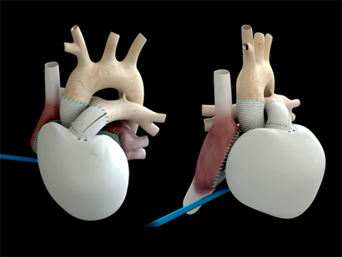
Artificial heart transplant technology (2)

Slide 16
Reg 3(1) – agent’s duty of good faith
Rossetti Marketing Ltd v (1) Diamond Safe Co & (2) Solutions Marketing Ltd [2012] EWCA Civ 1021

