Slide 1
Trench warfare in the Commercial Court: receiverships, committals to prison, refusals to hear contemnors, debarments and other relief
Stephen Smith QC, Erskine Chambers
Richard Lewis, Hogan Lovells

Slide 2
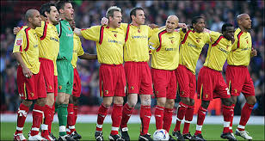

Slide 3


Slide 4
Developments in 1988
Duvalier v. Republic of Haiti
Babanaft v. Bassatne
Derby v. Weldon

Slide 5
Derby v. Weldon
No. 1 [1990] Ch 48
- Court may grant a worldwide freezing order (“WFO”) pre-trial
Nos. 3 & 4 [1990] Ch 65
- Court may appoint receivers in aid of a WFO
No. 6 [1990] 1 WLR 1139
- Court may order a defendant to transfer assets from one jurisdiction to another

Slide 6
Derby (Nos. 3 & 4)
Vice-Chancellor:
- where defendant is company incorporated overseas with no UK directors or assets, what is the point of a WFO (how does the Court enforce the WFO)?
Master of the Rolls:
- the Court assumes defendants will comply with its orders
- in the event of non-compliance, the Court may debar the defendant from defending

Slide 7
1989-2009
Little development of ideas
Very few reported examples of receiverships
- even in BCCI litigation
Some instances of unless orders being granted where defendants did not comply with disclosure orders
Committals seemingly rare

Slide 8
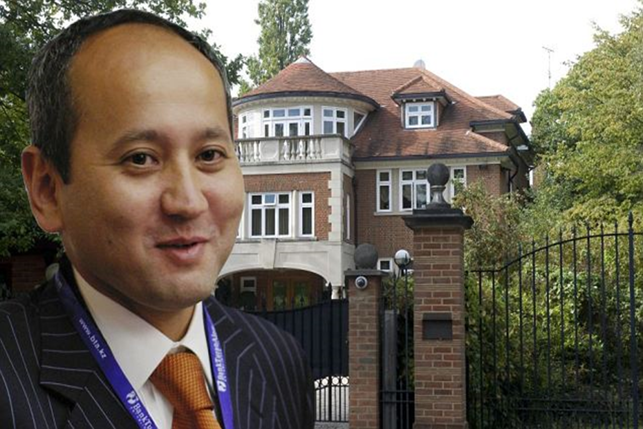
Mukhtar Ablyazov

Slide 9
2005-2009
MKA chairman of JSC BTA Bank
Also secret owner of 100s of offshore companies
Western banks lent US $billions to BTA
MKA caused BTA to “lend” US $billions to his secretly owned companies

Slide 10
2009
Credit crunch bites hard in Kazakhstan
BTA cannot meet obligations
Bank nationalised
MKA and senior management flee
Mainly to UK
Where apply for (and granted) asylum

Slide 11
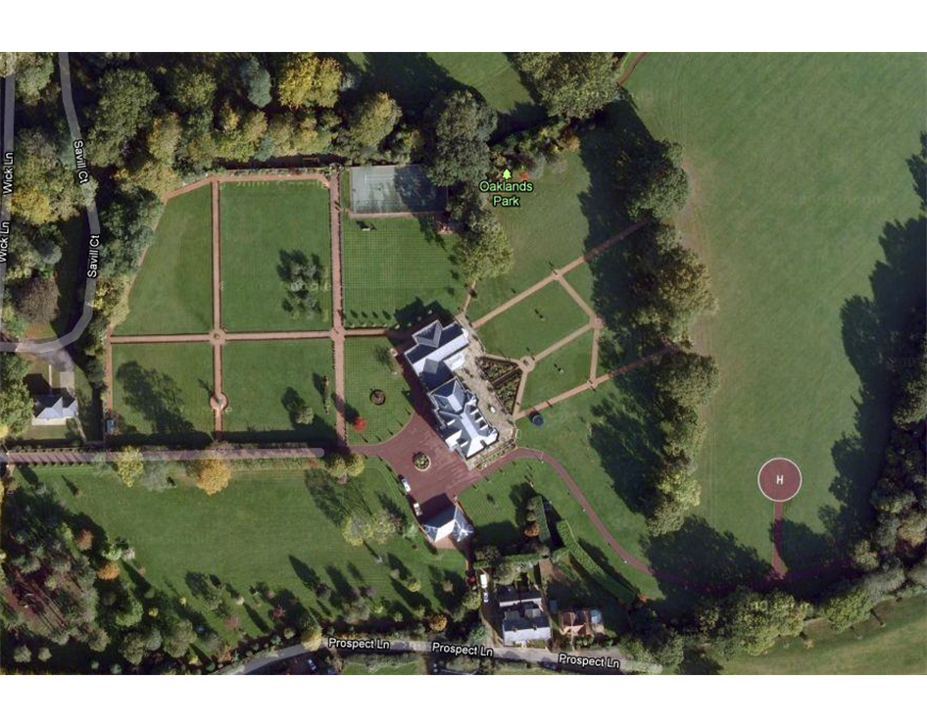
MKA’s weekend retreat

Slide 12
Litigation commences
August 2009 BTA commences first set of proceedings in England
In Commercial Court
Obtains WFO
“trench warfare” begins
Over 50 reserved decisions (10 so far in CA)
Judgment for US $3.7bn against MKA (interest accruing at rate of $750,000 per day)

Slide 13
BTA Decisions
1. [2009] EWCA 1125; [2010] 1 All ER (Comm) 1029: A judge had been entitled to make disclosure orders in support of a freezing injunction before the hearing of a substantive challenge to the freezing injunction.
[2009] EWCA 1124; [2010] 1 WLR 976; [2010] 1 Cr App R 9:
The Fraud Act 2006 s.13 had removed the privilege against self-incrimination in respect of an offence under the Proceeds of Crime Act 2002 s.328 because an offence under s.328 of the 2002 Act was a "related offence" within the meaning of s.13(4) of the 2006 Act.
3. [2009] EWHC 2833: It was appropriate and fair that a defendant attend for cross-examination upon his affidavits as to assets where the affidavits were inadequate in that they did not serve their purpose of enabling the claimant to police the operation of a freezing order.
4. [2009] EWHC 2840: Freezing injunction continued but disclosure subject to restricted information regime (lawyers can see but client cannot without further order).
5. [2009] EWHC 3267; [2010] 1 All ER (Comm) 1040: It was appropriate to vary the standard form of a freezing order as there was a real risk that the liberty provided in the order to deal with overseas assets might be used to put asset holders' assets out of reach of the claimant.

Slide 14
5. [2009] EWHC 3267; [2010] 1 All ER (Comm) 1040:
It was appropriate to vary the standard form of a freezing order as there was a real risk that the liberty provided in the order to deal with overseas assets might be used to put asset holders' assets out of reach of the claimant.

Slide 15
6. [2010] EWHC 545: Ex parte order obtained by defendant through material non-disclosure; whether hearings to be held in private.
7. [2010] EWHC 1799: In order to show that a receivership order in support of a freezing order was just and convenient, it would usually be necessary to show that the freezing order did not provide the claimant with adequate protection against the risk that the defendant's assets might be dissipated prior to judgment.
8. [2010] EWCA 1141; [2011] Bus LR 119: Receivership order upheld where defendant had not initially made adequate disclosure of his assets, which were held in a manner that made it difficult to trace, and where there was a measurable risk that he would deal with them in breach of the injunction; proper construction of ‘Angel Bell’ proviso.
9. [2011] EWCA 1436; [2011] 1 WLR 888: The words "his assets" appearing in the standard form of freezing order set out in the Commercial Court Guide included assets held as trustee or nominee for a third party.

Slide 16
8. [2010] EWCA 1141; [2011] Bus LR 119: Receivership order upheld where defendant had not initially made adequate disclosure of his assets, which were held in a manner that made it difficult to trace, and where there was a measurable risk that he would deal with them in breach of the injunction; proper construction of ‘Angel Bell’ proviso

Slide 17
9. [2011] EWCA 1436; [2011] 1 WLR 888: The words "his assets" appearing in the standard form of freezing order set out in the Commercial Court Guide included assets held as trustee or nominee for a third party.

Slide 18
10. [2011] EWHC 202; [2011] 2 All ER (Comm) 10: Claims by a bank controlled by the state of Kazakhstan for repayment of sums of money from its former chairman, where he denied the claims on the basis that they were politically motivated, were not actions involving the direct enforcement of a foreign penal, revenue or other public law; the nationalization of a foreign company was an act of state which was not justiciable in an English court.
11. [2011] EWHC 1136; [2011] 1 WLR 2996:
An insolvent Kazakh bank had not abused the court process by pursuing actions to recover misappropriated assets as it was unrealistic to suppose that the proceedings had not been brought, at least partly, for the legitimate purpose of recovering losses for the benefit of the bank and its creditors.

Slide 19
12. [2011] EWHC 1613: It was appropriate to proceed with a committal hearing in the absence of a respondent where the evidence showed that he was deliberately concealing his whereabouts and declining to respond.
13. [2011] EWHC 2908: A sentence of 18 months' imprisonment was imposed, in his absence, on a contemnor who had made no attempt to comply with an international freezing order, had not admitted to being in breach of it and had not put in any evidence in mitigation.
14. [2011] EWHC 1522: Pleading, disclosure and other issues of principle arising on a committal application.
[2011] EWHC 2500: Where a party had breached a freezing order over the life of the action against him and contempt proceedings were pending, it was not just to grant him security for his costs.
[2011] EWHC 2664: The power of the court to grant a freezing injunction extended to making any ancillary orders which appeared just and convenient to ensure its effective operation, including compelling disclosure of the ultimate source of funds used to pay legal expenses.
17. [2011] EWCA 1241; [2012] 1 WLR 350: Defendant sentenced to 21 months’ imprisonment for failure to comply with disclosure requirements of freezing injunction (punitive part 9 months).

Slide 20
17. [2011] EWCA 1241; [2012] 1 WLR 350: Defendant sentenced to 21 months’ imprisonment for failure to comply with disclosure requirements of freezing injunction (punitive part 9 months).

Slide 21
18. [2011] EWCA 1386: [2012] 2 All ER 575: Claimant entitled to proceed against a defendant in respect of a limited number of allegations of contempt of court, without having to abandon other allegations of contempt which it had raised and even though there was a degree of overlap between them and issues at the substantive trial.
19. [2012] EWHC 237: Ablyazov committed for breaches of freezing order and lying under oath (3 concurrent sentences of 22 months imposed).
20. [2012] EWHC 455: Where the court had issued a warrant for the committal of a contemnor and he had gone into hiding, the court could issue a mandatory injunction, ordering him to surrender himself to the tipstaff and debar him from defending the proceedings if he failed to do so.
21. [2012] EWHC 648: Receivers appointed managers of companies whose shares in receivership (thereby displacing directors)
22. [2012] EWHC 1252: Whether solicitors obliged to disclose further contact details for client; whether contact details protected by legal professional privilege.

Slide 22
[2012] EWHC 455:
Where the court had issued a warrant for the committal of a contemnor and he had gone into hiding, the court could issue a mandatory injunction, ordering him to surrender himself to the tipstaff and debar him from defending the proceedings if he failed to do so.

Slide 23
[2012] EWHC 648:
Receivers appointed managers of companies whose shares in receivership (thereby displacing directors)

Slide 24
23. [2012] EWCA 639: [2012] NJLR 757:
The court had jurisdiction to prevent a contemnor from pursuing his appeal against a committal order.
24. [2012] EWHC 1819: [2012] 2 All ER (Comm)1243:
The exercise of a right to have a lender pay money under a loan agreement was not a breach of a freezing order.

Slide 25
25. [2012] EWHC 1891:
A respondent to a Norwich Pharmacal Order who behaved "like an ostrich" and therefore gave inaccurate answers to questions contained in the order was not guilty of contempt of court.
26. [2012] EWHC 2543:
It was appropriate to order a defendant who had breached the terms of a freezing injunction by causing his companies to make pledges to Russian banks to use his best endeavours to intervene in any enforcement proceedings on the pledges to ensure that the Russian court was informed that the pledges had been made in breach of the injunction. The test for (retrospective) validation of transactions which breached a freezing order was not limited to showing that the transactions did not conflict with the purpose of the freezing order.
27. [2012] EWHC 2698; [2012] I.L.Pr.53
The court had jurisdiction to appoint a receiver in respect of a company for the purpose of giving instructions in connection with the continuation of proceedings, where the validity of the appointment of corporate directors was in doubt and a party was at risk of substantial injustice through lack of representation.

Slide 26
26. [2012] EWHC 2543:
It was appropriate to order a defendant who had breached the terms of a freezing injunction by causing his companies to make pledges to Russian banks to use his best endeavours to intervene in any enforcement proceedings on the pledges to ensure that the Russian court was informed that the pledges had been made in breach of the injunction. The test for (retrospective) validation of transactions which breached a freezing order was not limited to showing that the transactions did not conflict with the purpose of the freezing order.

Slide 27
27. [2012] EWHC 2698; [2012] I.L.Pr.53:
The court had jurisdiction to appoint a receiver in respect of a company for the purpose of giving instructions in connection with the continuation of proceedings, where the validity of the appointment of corporate directors was in doubt and a party was at risk of substantial injustice through lack of representation.

Slide 28
[2012] EWCA 1411; [2013] 1 WLR 1331: There was no reason to disturb the judge’s finding that the defendant had committed several contempts of court and should be sentenced to 22 months’ imprisonment. There was jurisdiction to make an order that the defendant surrender himself to custody. A full hearing of a claim on the merits was not required in circumstances where a litigant had forfeited his right to a full trial by his own conduct of the litigation. The judge had been entitled to make orders whereby the appellant would be debarred from defending the claims against him unless within a stated period he both surrendered to custody and made proper disclosure of all his assets and his dealings with them.
29. [2012] EWCA 1551; [2013] 1 WLR 1845:
A judge had not erred in refusing to recuse himself as the trial judge following his finding of contempt against a defendant, as there was no real possibility of bias and the defendant's failure to make a recusal application earlier in the proceedings had been an unequivocal, informed and voluntary waiver of his right to make such an application.
30. [2013] EWHC 510:
After a 44 day trial of 3 actions the Bank awarded damages of up to $1.56bn, plus interest against several defendants and an order for the transfer of a Port on the White Sea in Russia which was acquired with monies stolen from it.

Slide 29
29. [2012] EWCA 1551; [2013] 1 WLR 1845:
A judge had not erred in refusing to recuse himself as the trial judge following his finding of contempt against a defendant, as there was no real possibility of bias and the defendant's failure to make a recusal application earlier in the proceedings had been an unequivocal, informed and voluntary waiver of his right to make such an application.

Slide 30
30. [2013] EWHC 510:
After a 44 day trial of 3 actions the Bank awarded damages of up to $1.56bn, plus interest against several defendants and an order for the transfer of a Port on the White Sea in Russia which was acquired with monies stolen from it.

Slide 31
31. Teare J, unreported, 17.5.13:
The court was required to determine whether to permit a person (S), who was said to be in contempt of court, to be heard in opposition to the application of a Kazakh bank (B) for a final charging order in respect of a London flat. The court was required to determine whether to permit a person (S), who was said to be in contempt of court, to be heard in opposition to the application of a Kazakh bank (B) for a final charging order in respect of a London flat.
32. Teare J, unreported, 17.5.13:
The principle set out in Secretary of State for Trade and Industry v Bairstow, that it would be an abuse of process to challenge a decision in earlier proceedings where that would bring the administration of justice into disrepute, was wide enough to encompass the situation where a person was not a party to the earlier proceedings but only a witness. A collateral attack upon a judgment was an abuse of process where it was a witness in the first proceedings who was a party to the later proceedings seeking to effect the collateral attack.

Slide 32
32. Teare J, unreported, 17.5.13:
The principle set out in Secretary of State for Trade and Industry v Bairstow, that it would be an abuse of process to challenge a decision in earlier proceedings where that would bring the administration of justice into disrepute, was wide enough to encompass the situation where a person was not a party to the earlier proceedings but only a witness. A collateral attack upon a judgment was an abuse of process where it was a witness in the first proceedings who was a party to the later proceedings seeking to effect the collateral attack.

Slide 33
BTA – decisions awaited
CA decision on whether method of funding breach of WFO (and disclosure of payments)
CA decision on whether director in contempt when he said he had no information to give in answer to a disclosure order

Slide 34
BTA – future developments
Trials of third party claims to extract companies/assets from receivership
  Pleadings
  Disclosure
  Witness statements
  4-5 day trials
Appeals from the main trial (?)
Further committals
Long sleeves

Slide 35
Common Structure
Trustee/nominee
Offshore company 1
(BVI)
Offshore company 2
(Seychelles)
Offshore company 3
(Cyprus)
Operating company
(Russia)

Slide 36
Piercing corporate veil
Likely to be issue in some applications/trials
Prest v. Petrodel
Is it a doctrine? If so, does it really exist? Has it ever been properly applied? Has it ever really needed to be applied? Will it ever be needed in the future?
Legions of judges and academics and practitioners have been getting it wrong for decades
Trustor v. Smallbone
  “illegitimate application of the doctrine” (per Lord Neuberger)
  sed quaere

Slide 37
Group Seven Ltd v.
Allied Investment Corp
Hildyard J 6.6.13
Sole director/shareholder disclosed asset which in name of company as “his asset” for purposes of WFO
Claimant sought to commit him for (admitted) dealing
Application struck out: asset was not individual’s: belonged to company
May be appropriate to extend standard form order to assets which a defendant does not own “but which may in truth be available to him within a corporate pocket for the purposes of enforcement”

Slide 38

How wrong it can go…

